Slide 1
Generic Framework for Prioritizing Content of Interest in Multimedia Data Compression
Chong Shao
University of North Carolina at Chapel Hill
Advisor: Shahriar Njirjon, Russell Taylor
Notes:
XXX details about H.264: how it handles the region of interest ?????
XXX may add a backup slide for sliding window
Xxx read the nature paper
Xxx read the microscopy paper
XXX add formulas
XXX
Planned edit: add quality metric design result if I can have it
add navy data result
find out if there is a link between “efficient regression” in video decomposition and http://ieeexplore.ieee.org/xpl/articleDetails.jsp?arnumber=6803938, if no, remove that slide
http://radar.oreilly.com/2014/03/battery-technology-is-not-keeping-pace-with-computing-power-demands.html
http://wikiblinks.com/1-feature-the-iphone-desperately-needs-battery-life/
https://www.statista.com/chart/3780/tv-screen-size/
http://drpeering.net/white-papers/Internet-Transit-Pricing-Historical-And-Projected.php
http://blog.dshr.org/2016/05/talk-at-seagate.html
http://blog.dshr.org/2014/03/the-half-empty-archive.html
http://ieeexplore.ieee.org/xpl/login.jsp?tp=&arnumber=6269460&url=http%3A%2F%2Fieeexplore.ieee.org%2Fxpls%2Fabs_all.jsp%3Farnumber%3D6269460
http://dl.acm.org/citation.cfm?id=290814
http://ieeexplore.ieee.org/xpl/login.jsp?tp=&arnumber=4387595&url=http%3A%2F%2Fieeexplore.ieee.org%2Fxpls%2Fabs_all.jsp%3Farnumber%3D4387595

Slide 2
Background
Data Acquisition
Storage
&
Transmission
Data Consumption
Notes:
TODO: may replace with other diagram.. Think about it

Slide 3
Big picture idea
Notes:
Update the images

Slide 4


Motivating example
Compressing microscopy videos
Data Acquisition
Storage/Transmission
Data Consumption
Notes:
Update: XXX

Slide 5





Motivating Example
Store image data into Beacons
http://www.sierraclub.org/sierra/activism/saving-wild-places?page=7
Notes:
FINE

Slide 6
A slide talk about the size computation of JPEG
What is the JPEG compression process?
What is the formula of computing the JPEG?
Notes:
TODO: write an equaiton of compressed data size

Slide 7
Problem of Interest
Develop a new compression strategy for systems with extreme bandwidth limitation.
Notes:
TODO: Mathematical way of stating this problem

Slide 8
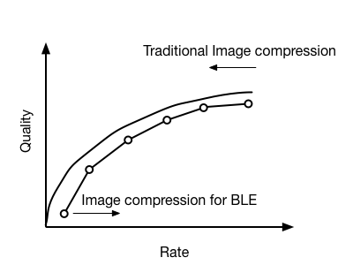
Summary
Notes:
XXX we construct the data instead of reducing the data…
How?

Slide 9
Thesis statement
Three new types of mismatch between video/image generator and consumer start to appear in modern multimedia systems that make current compression strategy inefficient. They are the mismatch on the quality requirement on the region of interest, the mismatch between energy constraints and the mismatch on frame resolution. Prioritizing the content of interest in these systems leads to new compression algorithms that give better compression ratio than standard methods with the same quality compressed data for the application.
Notes:
TODO: may need update

Slide 10
Microscopy compression

Slide 11
Goal
Increase in the amount of video data is faster than the increase in affordable data storage.
http://cismm.cs.unc.edu/core-projects/force-microscopy/high-throughput-microscopy/
Notes:
Microscopy systems with multiple channels that can generate multiple high resolution videos in short time

Slide 12


Research question
ROI
The capture side captures the entire frame, the viewer side only uses pixels in ROI
Notes:
TODO: replace the arrow with Legend
For this system, we have this …
Spherical lens / multiple microcamera
https://s3.amazonaws.com/aqueti.data/composites/03092014121300/03092014121300.tiles/index.html

Slide 13
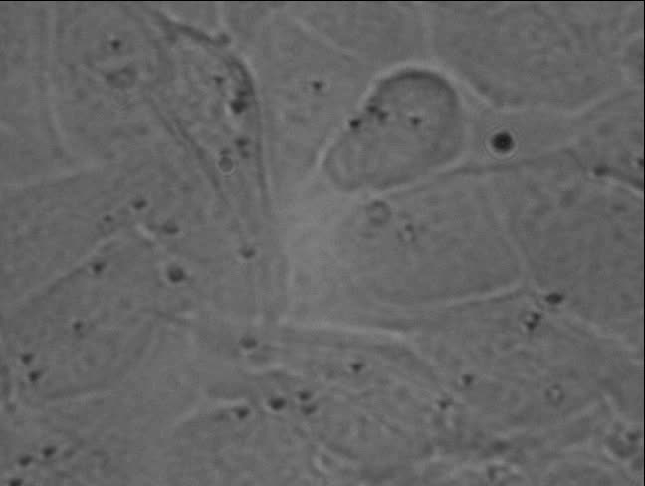
Video Compression
Require that the compression has no impact on analysis -- scientifically lossless
Standard (H.264) lossy compression techniques cannot be used
Standard lossless compression technique yields the compressed data in the size of 49.74% of the original one
Our method yields: 7.26%
Best case: 0.7729% vs. 19.4505%
Notes:
We designed a method gives the compressed data about 7% as the original
among all the cases we have, for one video our method got the best compression result 0.77% of the original data size while standard method has result of 19% on the same video

Slide 14
Related work
Method | Making use of temporal reduction | Compression ratio
JPEG | No | ~4
H.264 | Yes | ~5
Bernas et al. | No | ~9
Our method | Yes | ~100
Bernas T, Asem EK, Robinson JP, Rajwa B. 2006. Compression of fluorescence microscopy images based on the signal-to-noise estimation, Microsc. Res. Tech., 69: 1–9. doi: 10.1002/jemt.20259
Notes:
There are previous image / data compression technique out there,

Slide 15
Approach
Store only the information in a video that analysis can use
Separate every frame into foreground (pixels that carry information) and background (pixels that do not change throughout the video).
Average out noise in the background. -> easy to compress
Losslessly compresses the foreground regions
Notes:
Generate a new video by replacing every background pixel by its average value over time,
Compress the new video using standard lossless techniques
Since many of the pixels are constant over time in the new video, it will be easier to compress
The question left is How to tell a pixel F/B?

Slide 16

Key Observation
1. The noise is independent between neighboring pixels.
2. In the microscope image formation process, convolution with the point-spread function spreads image brightness changes in one pixel to its neighbors.
-> neighboring foreground pixels’ intensity over time values are correlated
http://en.wikipedia.org/wiki/Point_spread_function
Notes:
We can make use these two properties ina microsfopy video

Slide 17
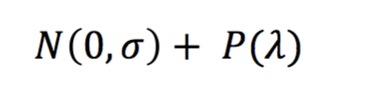
Modeling of noise

Slide 18
Foreground / background separation
Pearson’s correlation based method
High score: foreground
Notes:
Having a pixel intensity values over time , we xxxx
We take the mangnitude of the eight correltaion values,
And use the largest one as the score assigned to the center pixel
Higher score will suggest that it is foreground

Slide 19
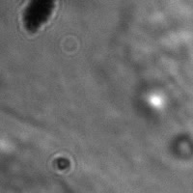
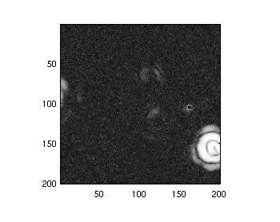
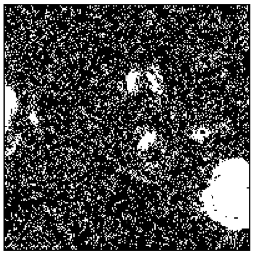
Foreground / background separation
Video
Plot of scores
Binary map
Notes:
We can do some thresholding on the scores to generate a binary map with the white region indicating the foregrounds

Slide 20

Approach
Store only the information in a video that analysis can use
Segmentation, correlation based method, make use of hardware
Encoding
Analysis (Quality evaluation)
Notes:
To better compress microscopy video, My Approach is to store only the information in a video that analysis can use
XXX add a frame with high correlation / low correlation pointers
With several steps,
In segmentation, make use of hardware, point spread function

Slide 21
Foreground / background separation
Correlation based method
Given a score how to tell it is foreground or background?

Slide 22
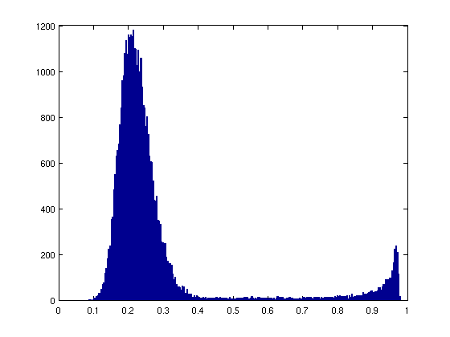
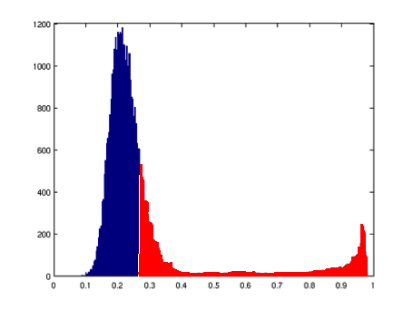
Foreground / background separation
Percentage based method (25%)

Slide 23
Refine the result: Key Observation
1. the noise is independent between neighboring pixels
2. convolution with the point-spread function present in the microscope image formation process spreads image brightness changes in one pixel to its neighbors.
-> Small “islands” should not be foreground, remove
Notes:
Which means that, in the binary map, the small while islands of one or two pixels should not be foregound and they should be removed

Slide 24
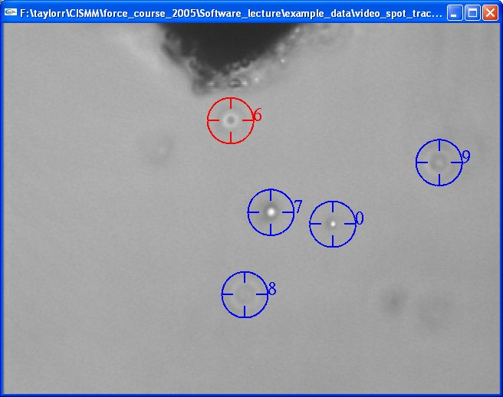
Video Spot Tracker
Notes:
In doing analysis on the object movement,
The software tracks the object by placing a tracker centered at the object
The tracking analysis does not only take the froeground pixels into account, also some background pixels inside the tracker

Slide 25


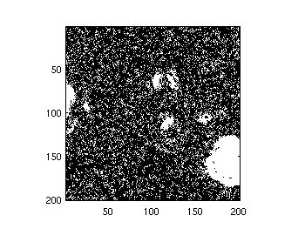
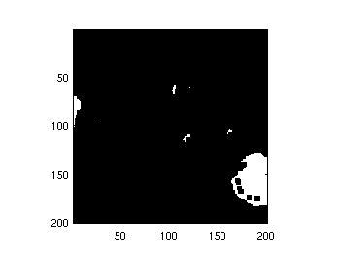
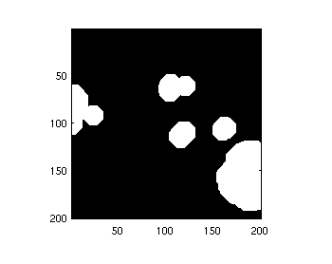
Refine the result Mathematical Morphology
erosion
dilation
3 x 3 pixels
Fit tracker size
Notes:
Gjiven a binary map, we want to remove the small white regions, we use a erosion operation with operator size 3x3 pixels, which removes the white islands smaller than t3x3 pixels
After the erosion, we dilate the result using a dilation operator with the size fit the tracker size, which will expand the foregound regions, then all the pixlels athat the video spot tracker uses in analysis will be losslessly compressed

Slide 26
Big picture
Notes:
Having the refined binary map, we generate a new video which has background pixels replaced by their averages over time
This video will be better compressd than the original video, we can also run the analysis to the check if it has the same result as the original video

Slide 27
Experiments
Two kinds of comparisons:
Keep it scientifically lossless
Compare based on compression ratio
Having the same compression ratio
Compare based on video quality
Notes:
Compare our method against standard lossless compression method in terms of compression ratio
Compare our method against other lossy compression method in terms of compressed video quality

Slide 28


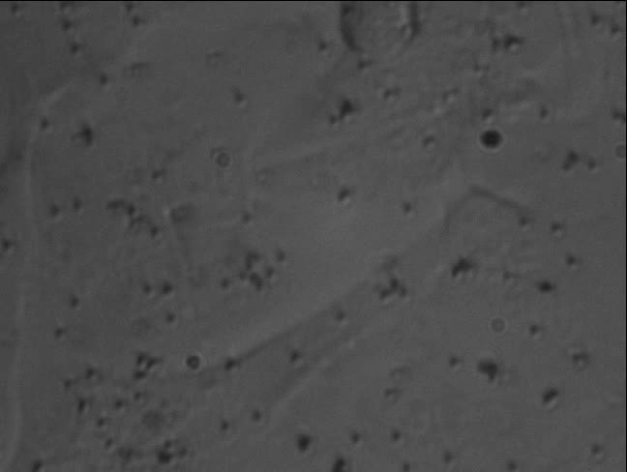
Experiments

Slide 29
Foreground / background separation
Percentage based
Set a hard coded value in thresholding the scores
The threshold 0.275 in range [0,1] works for all cases

Slide 30
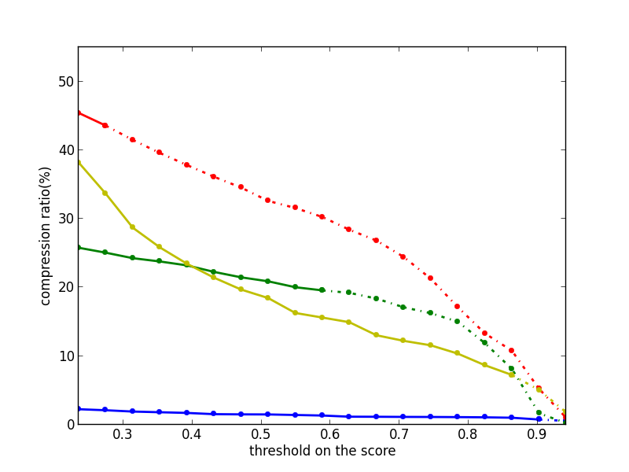
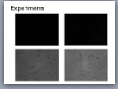
Results 1: compression ratio
(Using hard coded threshold)
Notes:
Horizontal axis: different threshold used , Vertical axis, Horizontal lines, Dotted line
solid… means with this threshold, the compression has no impact on analysis
Lines in the same color means they are using the same video
In all four cases, our method always outperforms standard method,
Arrow: more than 100x

Slide 31
Result: compression ratio
 | Video 1 (Beads 1μm) | Video 2 (Beads 500nm) | Video 3 (Brightfield 1) | Video 4 (Brightfield 2) | Video 5 (Cells)
H.264 | 20% | 28% | 47% | 50% | 33%
Our method | 0.77% | 20% | 44% | 7.3% | 4.8%
Notes:
I will show one prelimnary result…. Xxx explain the plot

Slide 32
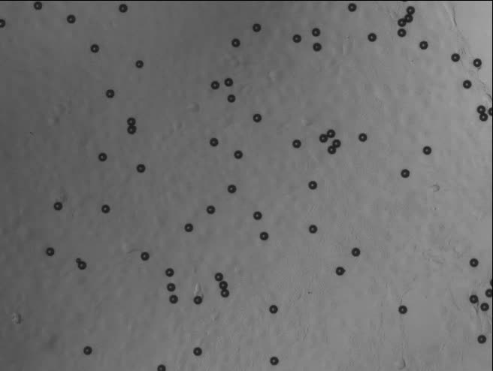
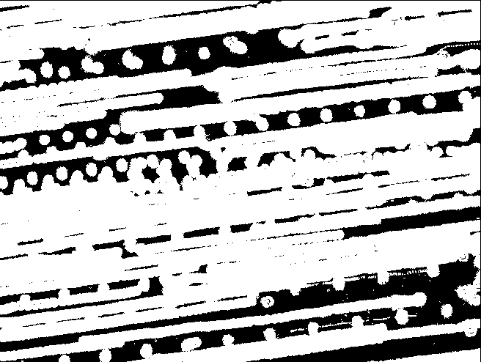
Quickly moving foreground objects
Notes:
In practice,
We have to label a pixel as foreground if is on the trajectory of the bead movement, in ttotal most of the pixels are marked as foreground

Slide 33
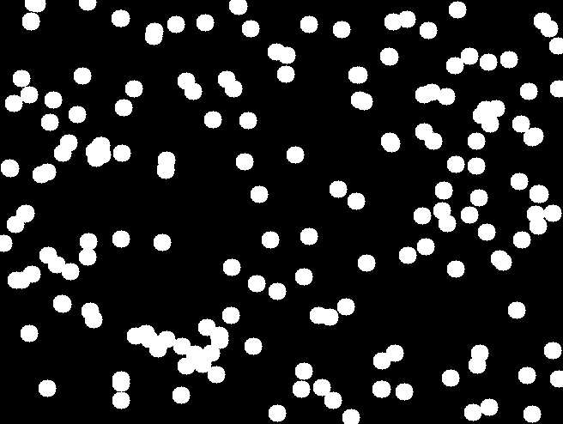

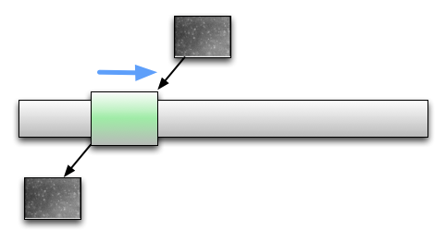
Sliding window
Window size?
Notes:
We do the correlation analysis based on the frames in the video
and store the frames based on the binary map generated in this analysis in the window
In the period when the foreground objects stay static, we don’t have many pixels marked as foregound,
Gives us a chance to better compress the video
Question is size

Slide 34
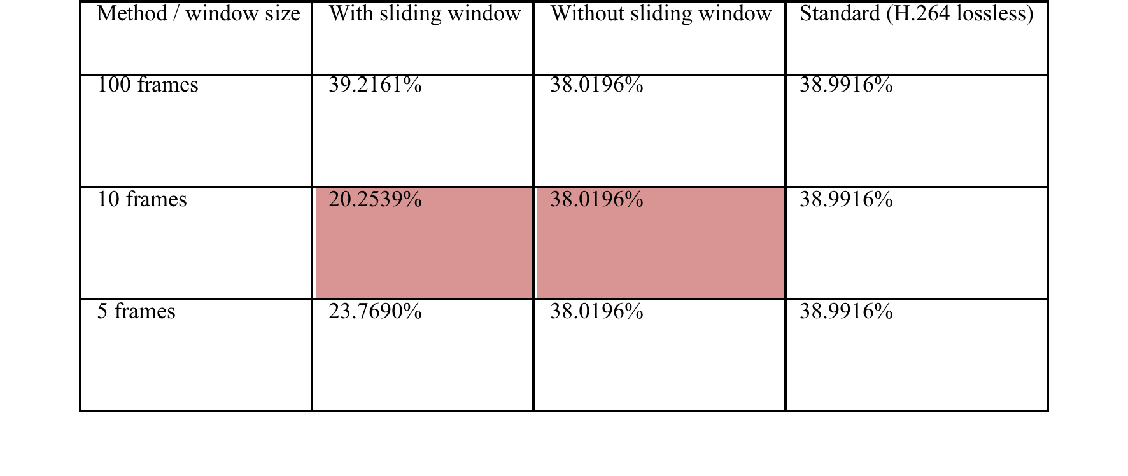
Sliding window
Notes:
Explain the table
You can expect the smaller window size is better than the larger one,
But the too small window size will make the background pixel average value keeps changing, this will make the result video to be harder to compress

Slide 35
Lossy Compression
We can do better if we allow lossy compression
Argue that the error introduced by lossy compression is like the error introduced by the random noise
Argue that the error introduced by lossy compression is under the error tolerance in the MSD analysis

Slide 36
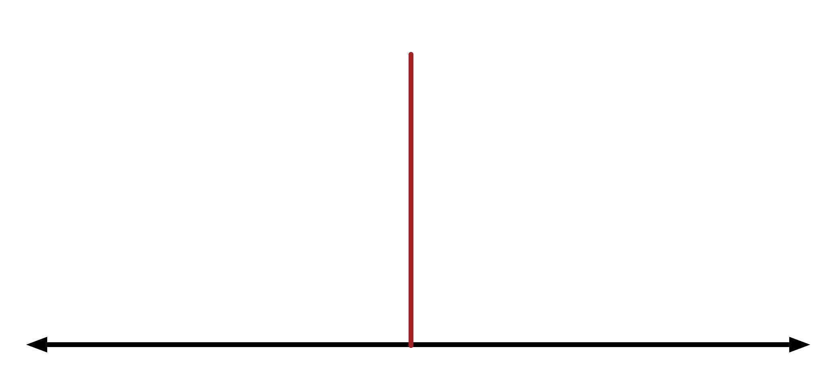
Analysis- Preserve compression

Slide 37
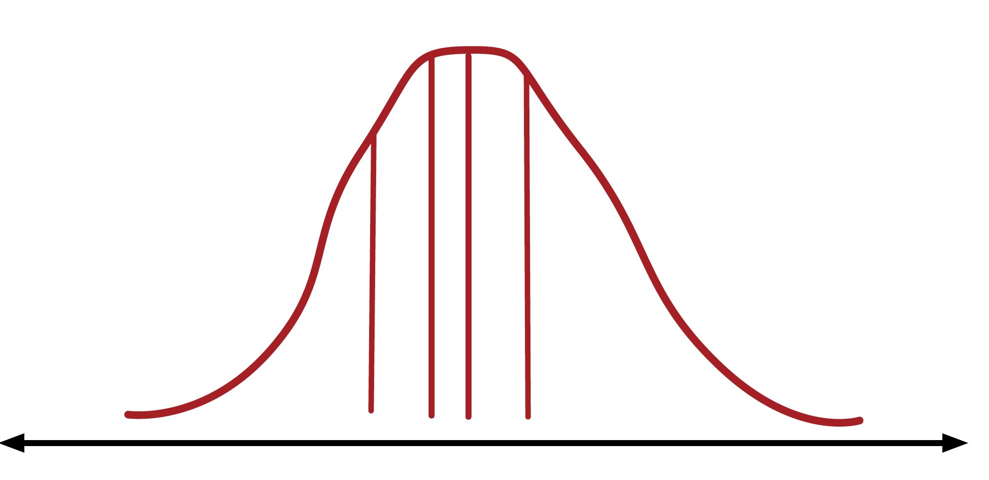
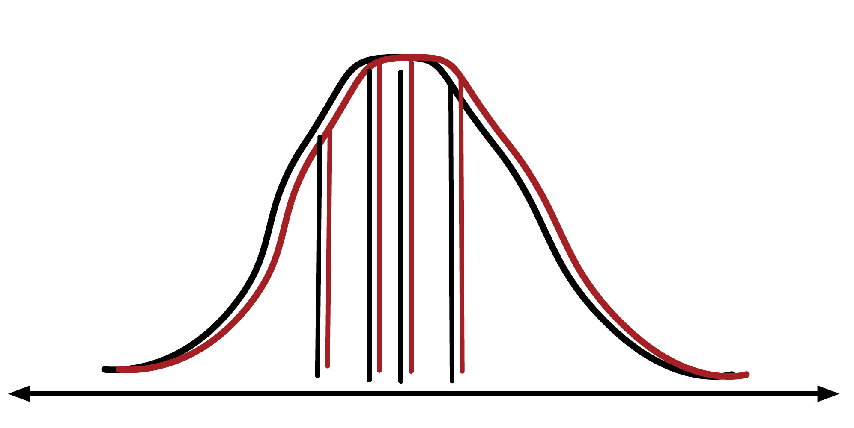
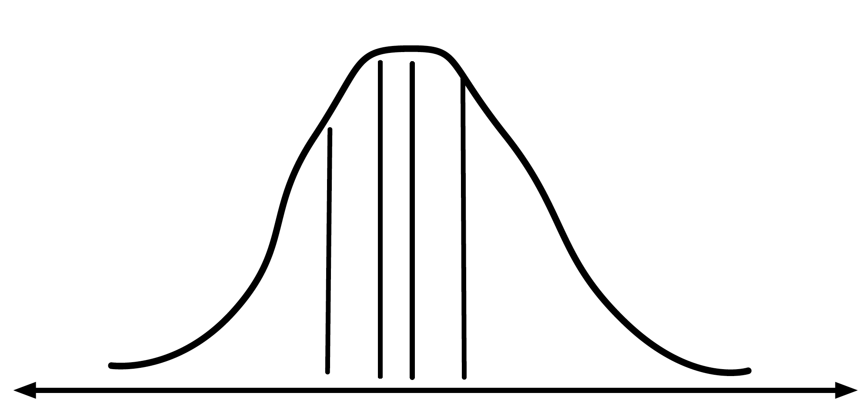
Analysis-Aware compression

Slide 38
Analysis-Aware compression
Useful
Notes:
XXX what is the parameter I changed ???

Slide 39
Analysis-Aware compression
KS test
KL divergence
Empirical distribution function

Slide 40
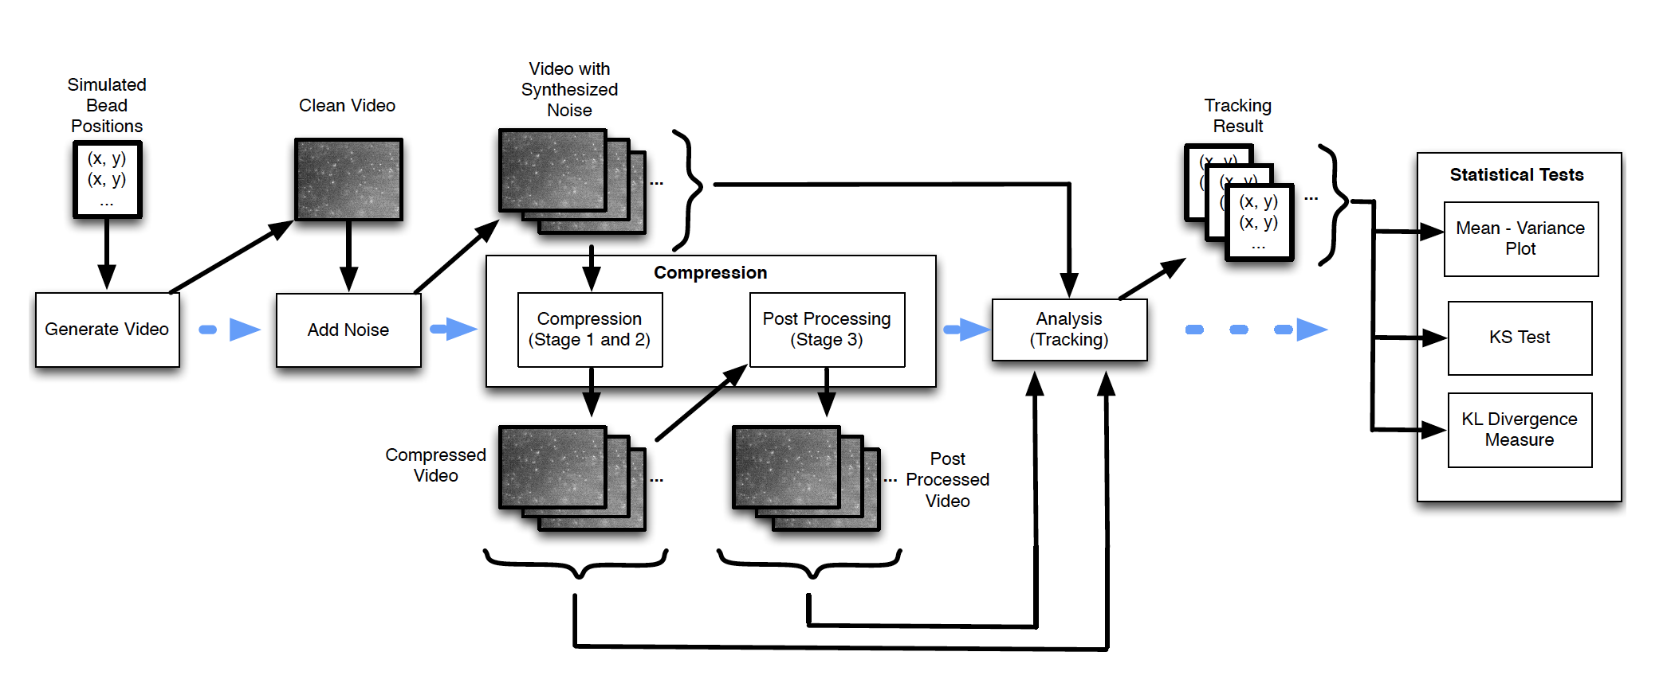
Analysis-Aware compression

Slide 41
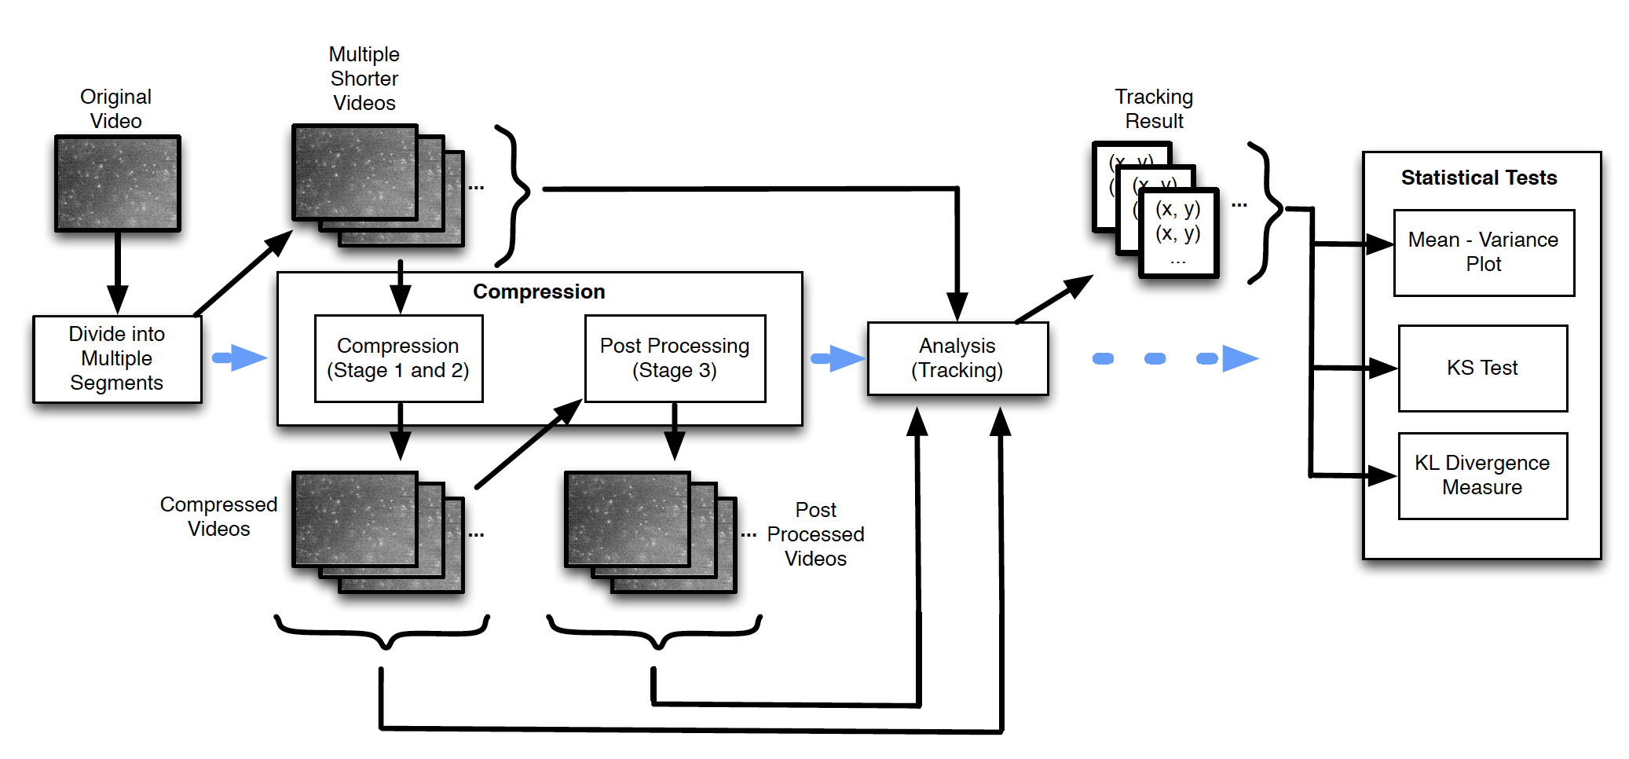
Analysis-Aware compression

Slide 42
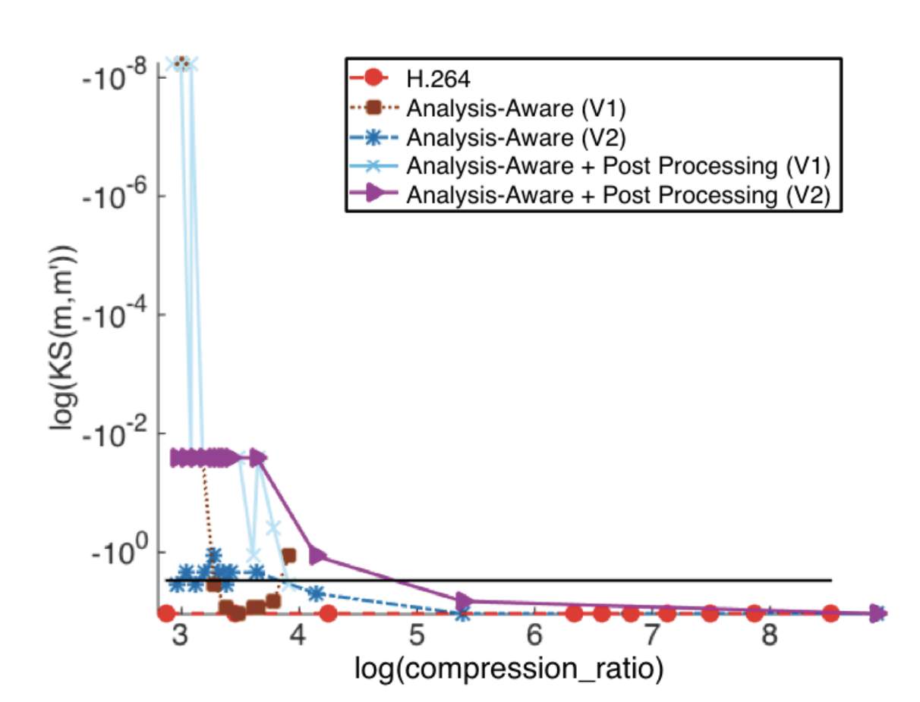
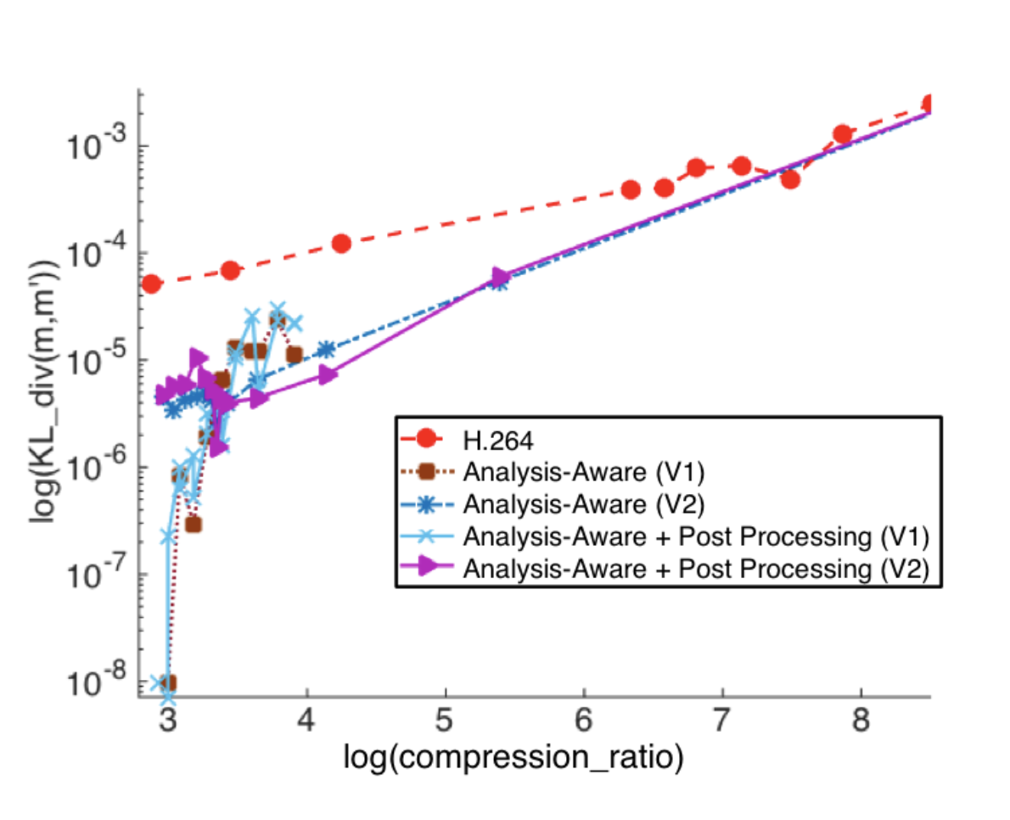
Analysis-Aware compression

Slide 43
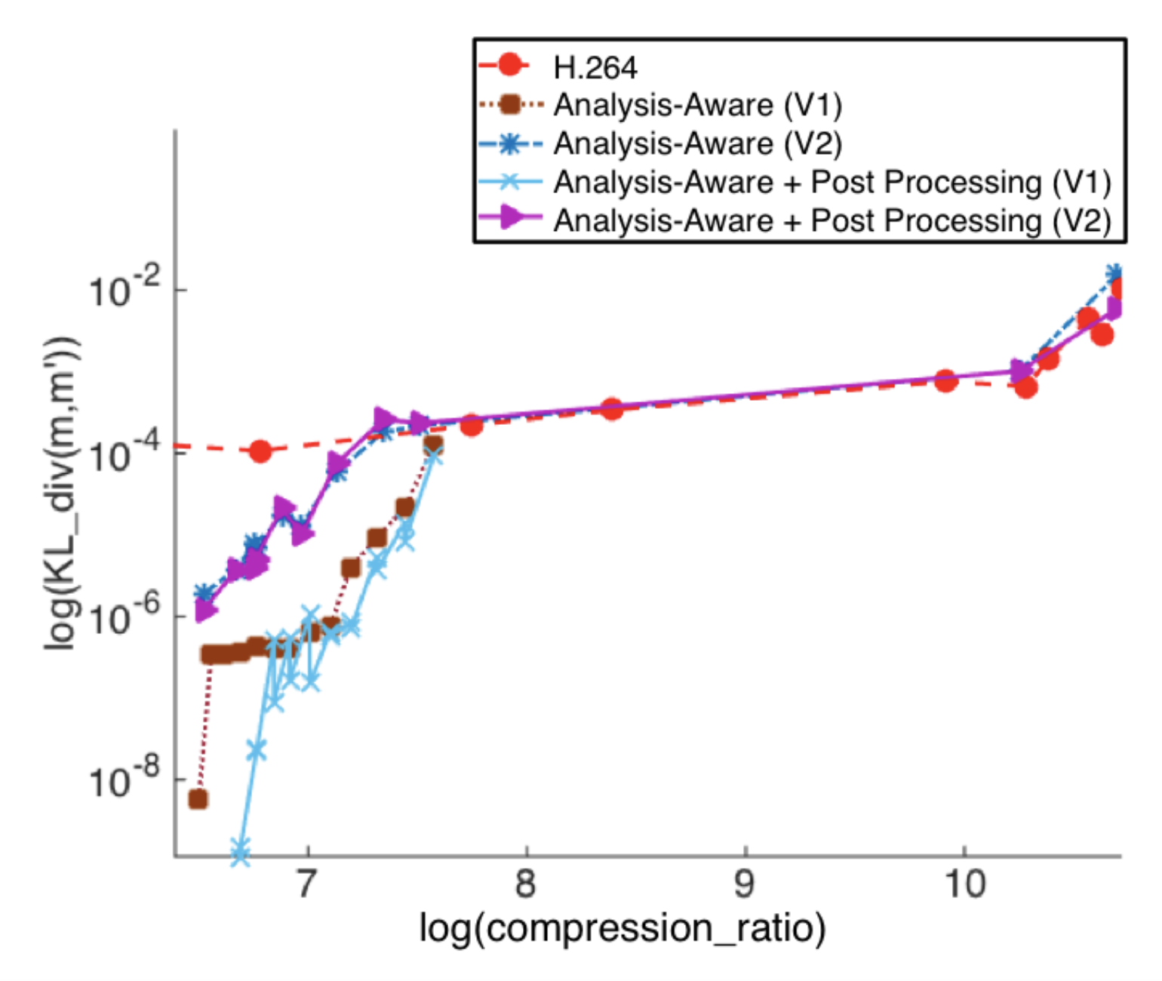
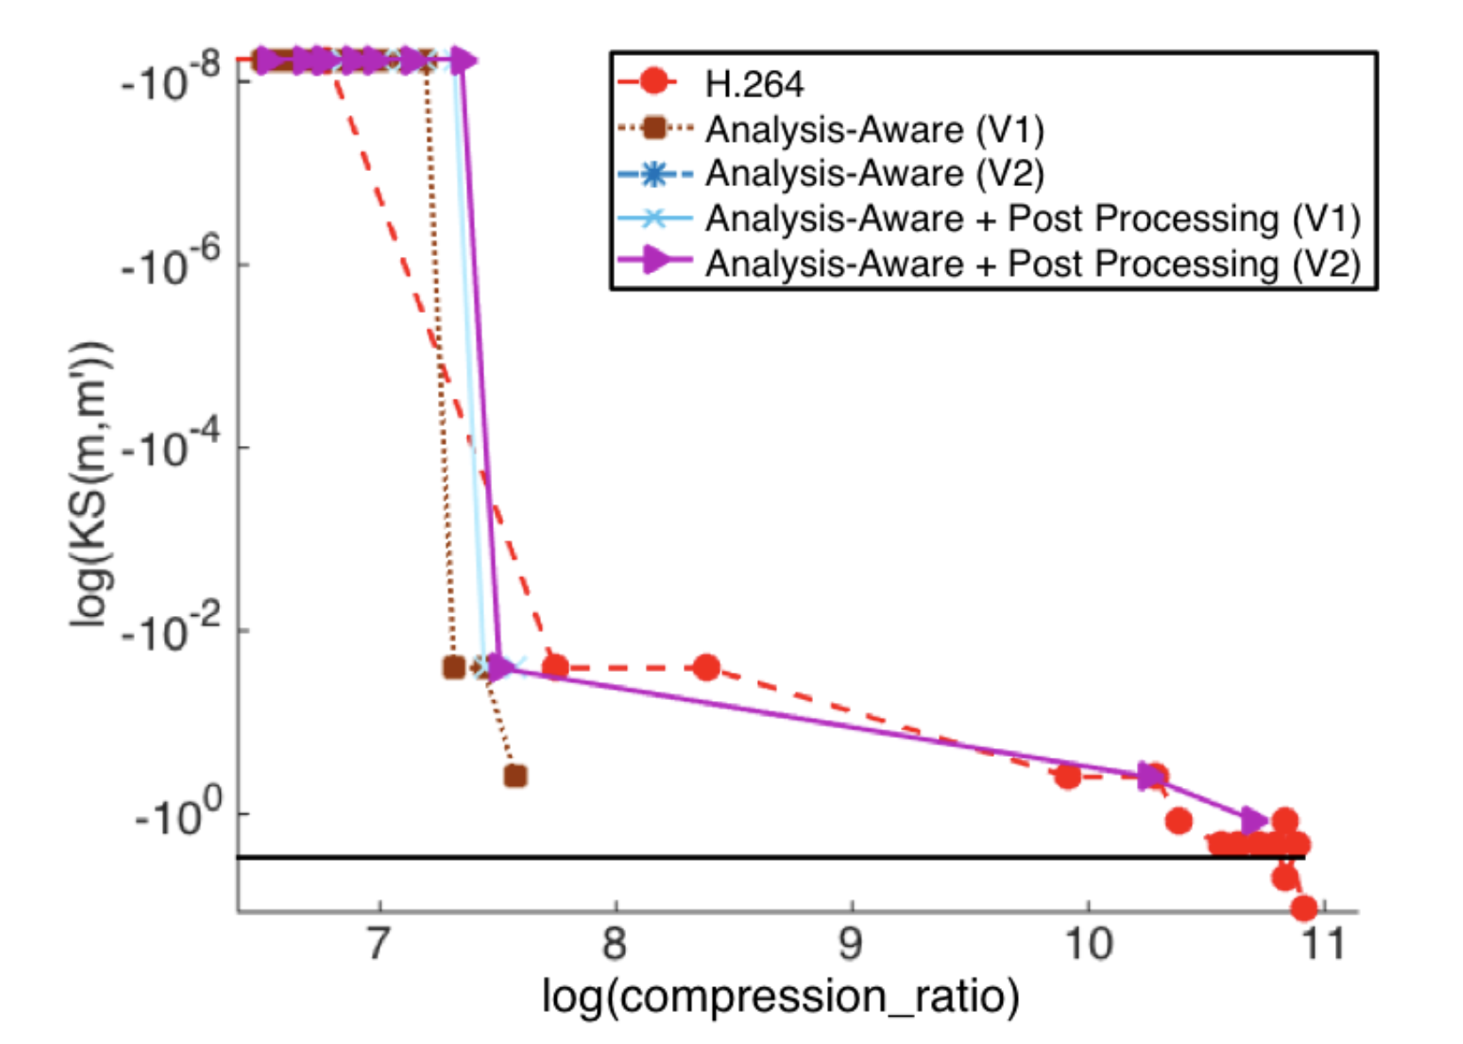
Analysis-Aware compression

Slide 44
Method Summary
Compression method based on correlation followed by mathematical morphology can give at most 100x compression
Extension: sliding window
100x video data compression
Identify the content of interest
Make use of optical property
Can be generalized to other optical systems
Notes:
XXX elaborate

Slide 45
Data compression for BLE

Slide 46




Background: BLE Beacon technology
StickNFind
Qualcomm Gimbal
RedBear Beacon B1
Estimote
GeLo
KST Particle
Devices that broadcast small pack of data to nearby portable electronic devices.
Protocol designed to enable devices with low power consumption.
Only transmits small packets.
Long lifetime: 3~5 years
http://blog.estimote.com/post/57087851702/preorder-for-estimote-beacons-available-shipping
http://localz.com/blog/ibeacon-ble-hardware-commercial-comparison/
2
Notes:
We can consider Data flow in multimedia system has three stages
I will show three examples of multimedia system

Slide 47

Background: BLE Beacon technology application
http://prismdevkit.com/lesson-8-an-intro-to-estimote-beacons/
Notes:
Shows typical use case
System briefly knows where you are
-This technology enables applications in several domains including ….
-serie of Use cases:
Customer can get advertisements in the entrance, do automatic checkin and rewarded with coupons,
With indoor location feature, the beacon delivers to cumster the information of the products that are close to the customter,
They can even do smooth checkout withit
Customer behavior analysis: Pierdicca et al. (2015)
Indoor localization: Martin et al. (2014)
Room occupancy detection: Conte et al. (2014)

Slide 48
Why you need image transmission from beacon devices?
Google Physical Web, Fat Beacon
Beacon deployment for places with no Internet connection

Slide 49

Challenge: Battery Life constraint
Notes:
TODO: may update plot
https://files.readme.io/m5rzEic2TcyB3k1HLrQw_beacon_energy_consumption.png

Slide 50
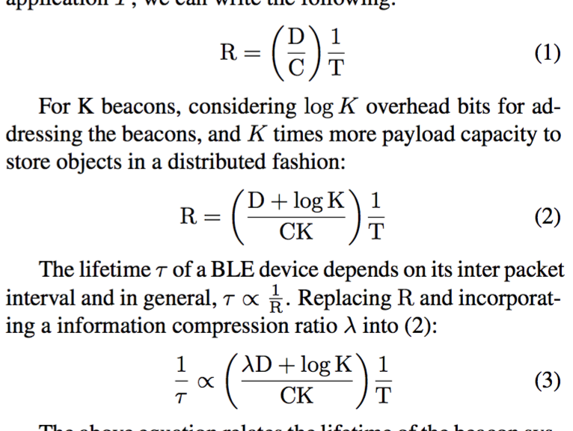
Challenge: Battery Life constraint
Notes:
TODO: write down the formulas

Slide 51

Challenge: BLE packet format
iBeacon packet format
Limited broadcasting data packet size
4 Bytes in iBeacon mode (UUID is not changeable via API)
18 Bytes using Eddystone URL mode
Future: BLE 5.0 with 8x broadcasting capacity: ~256 bytes
-> We must compress the images
http://www.argenox.com/bluetooth-low-energy-ble-v4-0-development/library/a-ble-advertising-primer/
Notes:
TODO: find deeper hack’s memory limit
-The major challenge we face is the extremly limited storage space of BLE beacons
-Diagram iBeacon packet foramat
- With the ibeacon format and SDK, what the user can use as storage space is 4 bytes
-details: naively using the ibeacon protocol that broadcasting uuid, major and minor values, we cannot change the UUID so we only got 4 bytes each beacon
Eddystone
Deeper hack: maximum xxx bytes
A typical image with small size (64 x 64) can easily exceeds 5 thousands bytes

Slide 52






Challenge: Conventional compression is not good enough
A typical simple shape 64x64 JPEG format image: 400 bytes ~ 2KB
For the “Lena” image:
Default quality
8549 Bytes
Quantization
level 20
1077 Bytes
Default quality
1382 Bytes
Quantization
Level 20
732 Bytes
Simple threshold
637 Bytes
Canny
1268 Bytes
Chain
Coding:
427 Bytes
Notes:
Put here: simple shape such as a image of disk it’s size
for a more complicated image such as Lena
The first row is all JPEG compression
JPEG is about tranferring signal into freq space and downsampling
Quantization is like downsampling in frequency space
What else is there besides JPEG? Backup slide ready for that.
Cite state of art color image compression codec
Tree-based image compression paper

Slide 53



Today’s talk
Constraint data type (DCOSS 16)
Make use of hardware (IOTDI 17)
3D motion data, visual feature data (MARBLE)
Notes:
Another thing we can do is to constrain the image type
For each image type, there exist compression methods specifically designed for it

Slide 54
Related work
Method | Binary Image | Color Image | Result small enough for BLE
Chain-coding | ✔ | ✖ | ✔
JPEG | ✔ | ✔ | ✖
Shapiro et al. | ✔ | ✔ | ✖
Lu et al. | ✔ | ✔ | ✖
Our method | ✔ | ✔ | ✔
Notes:
XXX[ drop something like sizes … ]
This table shows the related work. Including some other image compression tec
Jerome M Shapiro. 1993. Embedded image coding using zero trees of wavelet coeffcients.IEEE Transactions on signal processing41, 12 (1993), 3445–3462
Tianyu Lu, Zisheng Le, and DYY Yun. 2000. Piecewise linear image coding using surface triangulation and geometric compression. In Data Compression Conference, 2000. Proceedings. DCC 2000. IEEE, 410–419
hniques

Slide 55

Patch-based compression
Patches are matched based on Structural Similarity (SSIM)
Beacons store / broadcast indices of patches
Notes:
Each grid is similar to this patch
To geenrate the set of patches, one approach that acdtually works very well is to use spiral images
“Having one spiral does not always help,
Having an array of spirals is more effective “

Slide 56

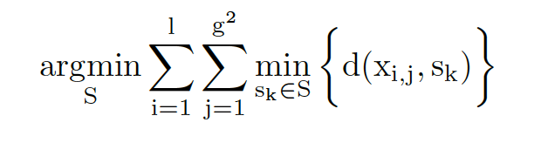
Patch-based compression
Set of spiral patches derived from K-means clustering

Slide 57


Compression result
CR: compression ratio
Notes:
Morphology: small island removed, connected component enhanced
Using a very trivial encoding: store all indices, the compression ratio is already very good
This plot comparison between our method and JPEG
In some areas, you can have some images what my method works better than jpeg: better quality and lower size.
Blue: you need around half a dozen or two dozen
Red: 2 or four beacons

Slide 58
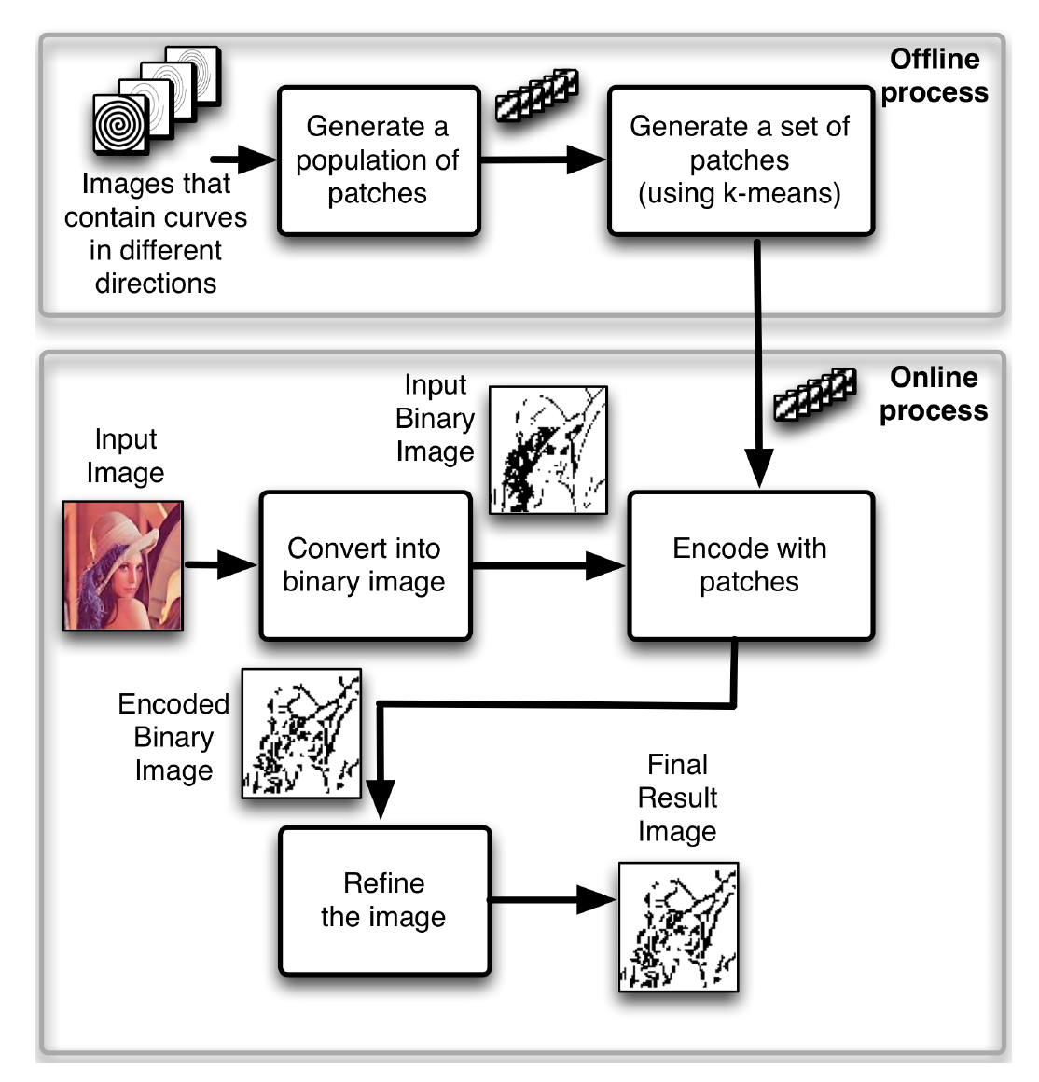
Overall Process
Notes:
We generate a large population of patches using images…
When we do k means

Slide 59


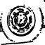
Evaluation
Varying parameters (beacon number, image type, k-means settings..)
Plot image quality vs. device lifetime.
Life time is estimated from API. We did not wait 60 months!
Notes:
alpha-numerical character, shapes, images,
Lena image and xxx
Basiccaly Evaluation goal is to tune the parameters, let us understand the impact of changes of different settings
The analysis is to analyze the approximated images quality vs device lifetime. Under different settings
such as different number of beacons and image quality, different type of images, and different parameters in k-means clustering …
Setting: has to arrive in 1s
The underline logic is that different settings will result in different encoding image size, which gives the number of packets transmitted under 1s, this impacts transmission frequency, turther device lifetime

Slide 60

Evaluation
Adding more Beacons gives a better image quality, but when the number of Beacons is larger than 3 the improvement is not significant.
Notes:
This plot shows the system performance using different number of beacons

Slide 61
Evaluation
K-means on multiple spiral patches performs better than using single spiral. K-means on MNIST patches outperforms K-means on spiral patches on the Alpha-Numeric dataset.
Notes:
This shows the image approximation performance for 3 types of images, here we also tried to make a patch generated from k-menas on MNIST handwritten digit dataset
For arbitrary image, k means on spirals is better when the available data storage capacity is more limited, but it does not do better than MNIST in high frquency setting
K = 64, patch size = 8 pixels

Slide 62

Reading-writing into Beacon
12 participants
Notes:
- WE also did some user study
-Goal: Test if the user write image can be read by another one
-12 participants
-We had drawing
-Better to expand in the whole screen, not being symbols that are easy to confused with other symbols “o”

Slide 63








Navigation test
5 participants
Notes:
-Goal: simulated remote navigation / hiking system
-5 participants
- deployed 6 beacons with navigation information in 6 locations in the building’2 and 3 floor
- follow the iamges from xx to xx, displayed on the screen
- route like this
- Free to give up
Finally we ask their idea of the clearness of the signs
－ 4 of 5 participants successfully completed the route,
1 gave up because of xxx
This drags down the user’s subjective socre of image 3
we believe with more careful deploying, the technology can be useful in customized navigation without internet connection
http://cs.unc.edu/files/2013/12/brooksbuildingsmall.jpg

Slide 64



Color image: approach
Region of interest
Foreground, adaptive encoding:
DCT
Wavelet
Triangle mesh
Background:
Down sample -> DCT
Notes:
Region of interest: foregorund / background
Allocate more bits describe the foreground
Still needs to preserve the background to give some context info

Slide 65
Segmentation
Generating an accurate segmentation
Apply a good encoding method for foreground region
Notes:
Single image-based, segmentaiton, such as watershed based method some times are not accurate,
Depth based method requires multiple view caputre, tends to be noisy
Combine the two results

Slide 66
Image encoding
Reduce mesh density
Reduce frequency component coefficients / quantization
Notes:
Foreground and background processed separately
We would like to control the size/quality of the foreground, For DCT wavelet, reducing the frequency compoent coeffs, for triangulariztio, we can reduce mesh desity

Slide 67
System
How to find a good pair of images?
- Use IMU signal
Notes:
Here we have another optimization here: the good pair of images may not be easy to find: the user may need to try many times.
We design and implemented a IMU guided capture

Slide 68
Video
XXX
Notes:
Here we have another optimization here: the good pair of images may not be easy to find: the user may need to try many times.
We design and implemented a IMU guided capture

Slide 69
Evaluation
IMU-guided view capture
Sensor readings: rotation vector, acceleration vector
Train a decision tree model
Use the model and IMU reading to predict the good pair of images
Notes:
Reduce the time of find a good pair of images,
Training phase, we record the sensor data, labeled each one by the depth map qualty
Train decision tree model
Use to predicdt the good pair of iamges

Slide 70

Evaluation
Notes:
Contains road signs, buildings, indoor / outdoor bojects

Slide 71
Evaluation
Notes:
Green color curve: jpeg, Beat jpeg again

Slide 72
Evaluation
Varying image type
Varying number of
beacons
Notes:
:Plot 1 shows building images has larger part as foregrorund, this makes it cost more energy to deliver a good quality
Plot 2 Similar to the binary iamge case,

Slide 73


Evaluation (User Study)
Recognize objects
Notes:
Have four group of objects
Compress image of one object in every group,
Let participant guess which one it is

Slide 74
Another example: augmented reality

Slide 75

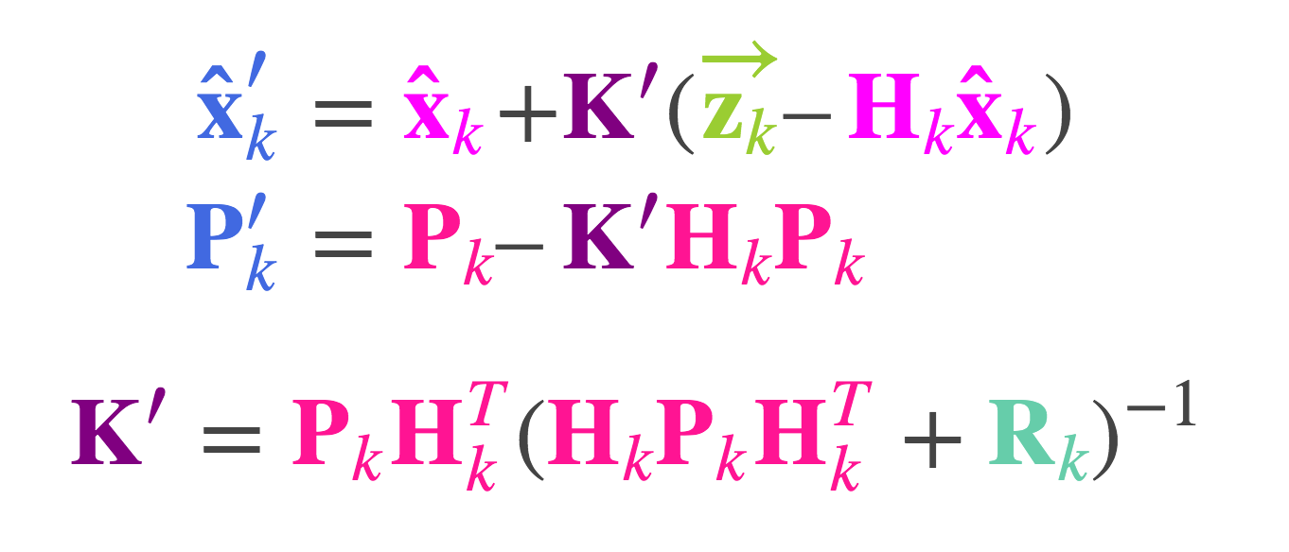
Data to store in the system
3D motion avatar
Localization
IMU camera rotation/acceleration data
Camera visual feature data
BLE signal strength
Sensor fusion

Slide 76
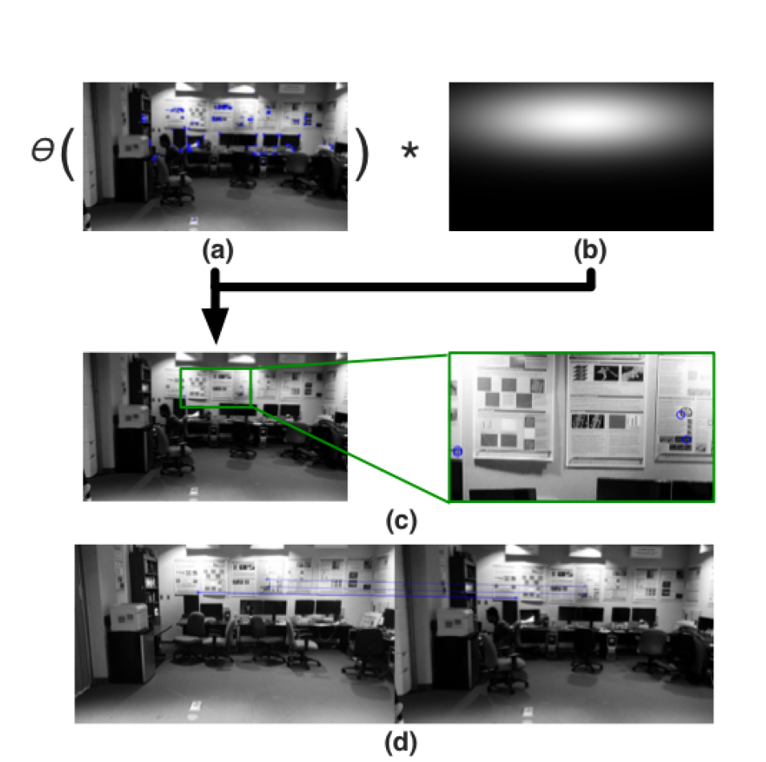
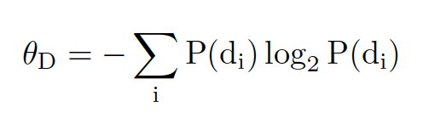
MARBLE
Reducing the number of features

Slide 77
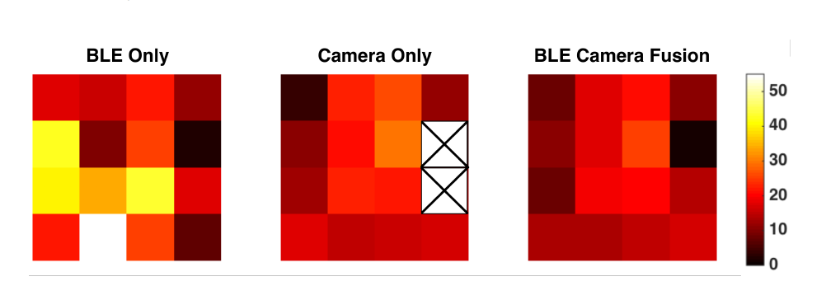
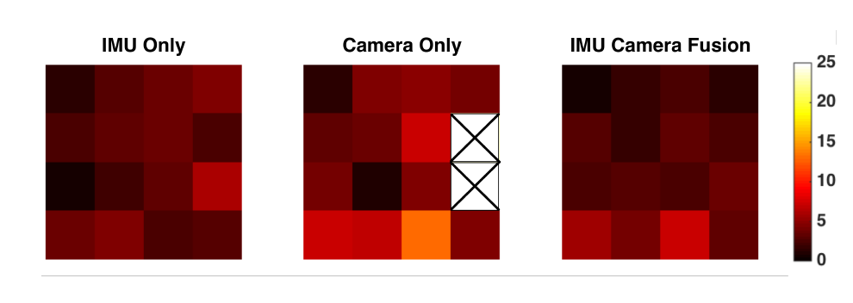
Evaluation

Slide 78
Method Summary
Three new systems for multimedia data storage / broadcast via BLE
Identify the content of interest
Make use of hardware

Slide 79
Conclusion
I explained the data compression techniques for systems with mismatch on the quality requirement on the region of interest, the mismatch on energy constraints and the mismatch on frame resolution.
The compression techniques uses the same approach: prioritizing content of interest
Notes:
OK

Slide 80
Papers
Published:
1. Shao, C., Zhong, A., Cribb, J., Osborne, L. D., O'Brien, E. T., Superfine, R., ... & Taylor, R. M. (2015). Analysis‐preserving video microscopy compression via correlation and mathematical morphology. Microscopy research and technique, 78(12), 1055-1061.
2. Shao, C., Nirjon, S., & Frahm, J. M. (2016, May). Years-Long Binary Image Broadcast using Bluetooth Low Energy Beacons. In Distributed Computing in Sensor Systems (DCOSS), 2016 International Conference on (pp. 225-232). IEEE.
3. Shao, C., & Nirjon, S. (2017) ImageBeacon: Broadcasting Color Images over Connectionless Bluetooth LE Packets. In Proc. of 2nd IEEE International Conference on Internet-of-Things Design and Implementation (IoTDI 2017), 12 pg,
Under Submission/In Preparation:
4. Shao, C., Cribb, J., Osborne, L. D., O'Brien, E. T., Superfine, R., ... & Taylor, R. M. Analysis‐aware video microscopy compression, Microscopy research and technique
5. Shao, C., Islam, B., & Nirjon, S. MARBLE: Mobile Augmented Reality Using BLE Beacons
6. Shao, C. et al, Optimal Temporal Slice Size for Streaming Regions of High Resolution Video
Other work as coauthor:
7. Cribb, J.A., Osborne, L.D., Beicker, K., Psioda, M., Chen, J., O’Brien, E.T., Taylor II, R.M., Vicci, L., Hsiao, J.P.L., Shao, C. and Falvo, M., 2016. An automated high-throughput array microscope for cancer cell mechanics. Scientific reports, 6.
([1, 4, 7]: region of interest mismatch; [2, 3, 5]: energy constraint mismatch; [6]: resolution mismatch)
Notes:
OK

Slide 81
Thank you!
Questions?
Notes:
OK

